Slide 1


Salary Prediction for Data Professionals
Presented by: Ambeshree Koli

Slide 2
CONTENTS:
Introduction
Project Objectives
Dataset Description
Data Exploration
Handling Missing Values
Exploratory Data Analysis (EDA)
Correlation Analysis
Data Preparation
Model Selection
Conclusion

Slide 3
INTRODUCTION
This project aims to predict the salaries of data professionals using machine learning algorithms. By analyzing a rich dataset, we identify key factors such as experience, education, job role, and location that influence salary levels. Accurate salary predictions benefit job seekers, employers, HR analysts, and researchers by providing data-driven insights and competitive salary benchmarks. Our objective is to develop and evaluate models to forecast salaries accurately, ultimately offering valuable recommendations for stakeholders.

Slide 4
OBJECTIVES
Data Analysis: Perform exploratory data analysis (EDA) to understand the distribution and relationships within the dataset.
Feature Engineering: Identify and transform key features that influence salary, enhancing the predictive power of the models.
Model Development: Develop and compare multiple machine learning models, such as Linear Regression, Decision Trees, Random Forests, and Gradient Boosting.
Model Evaluation: Assess model performance using metrics like R-squared, Mean Squared Error (MSE), and Mean Absolute Error (MAE) to identify the best-performing model.
Insights & Recommendations: Derive actionable insights from the model results and provide recommendations for stakeholders.

Slide 5
DATASET DESCRIPTION
Features:
  PAST EXP, DESIGNATION, AGE, SEX, UNIT, SALARY, etc.
Target Variable: SALARY
Splitting the Data:
  Features (X) and target (Y) separation.
  Train-test split: 80% training, 20% testing.
  Shape of training and testing sets.

Slide 6




Data Exploration
Initial Insights:
  Shape of the dataset: 3958 rows, 12 columns.
  Summary statistics and data types.
  Checking for missing values and handling them.

Slide 7
Handling Missing Values
Steps Taken:
  Replaced null values with zero.
  Impact on data: Ensured no missing values remained.

Slide 8
Exploratory Data Analysis (EDA)
Key Visualizations:
Distribution of Past Experience
Average Salary by Age
Histogram of dataset features
Average Salary by Designation

Slide 9
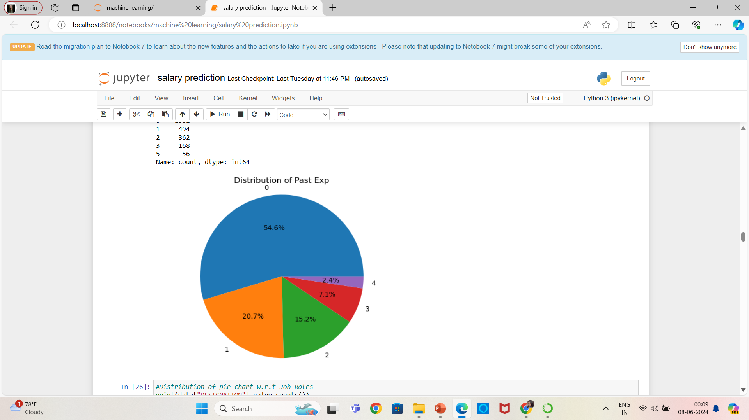
Distribution of Past Experience

Slide 10
Correlation Analysis
Correlation Heatmap:
  Process of dropping irrelevant columns.
  Conversion of categorical values to binary.
  Heatmap to visualize correlations between features.

Slide 11
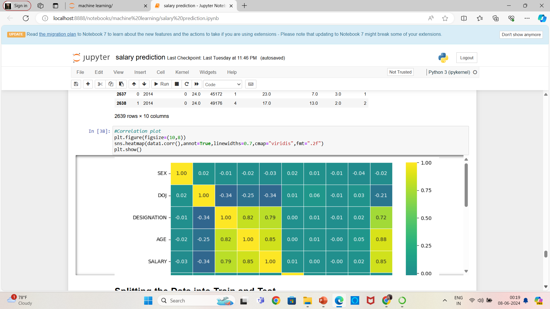
EX: Heatmap to visualize correlations between features

Slide 12
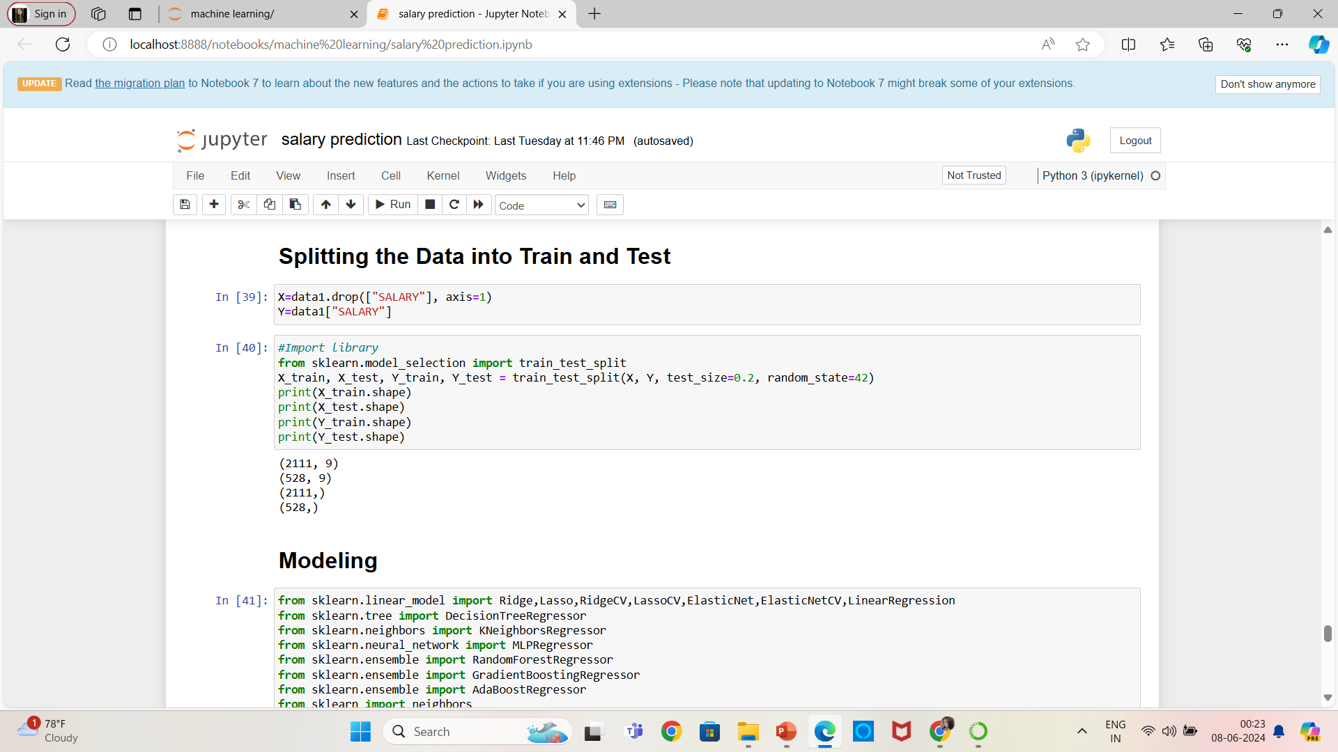
Data Preparation
Splitting the Data:
Features (X) and target (Y) separation.
Train-test split: 80% training, 20% testing.
Shape of training and testing sets.

Slide 13
Model Selection
Chosen Models:
Decision Tree Regressor
K-Neighbors Regressor
AdaBoost Regressor
Support Vector Regressor (SVR)
Ridge, Lasso, Random Forest, Gradient Boosting

Slide 14
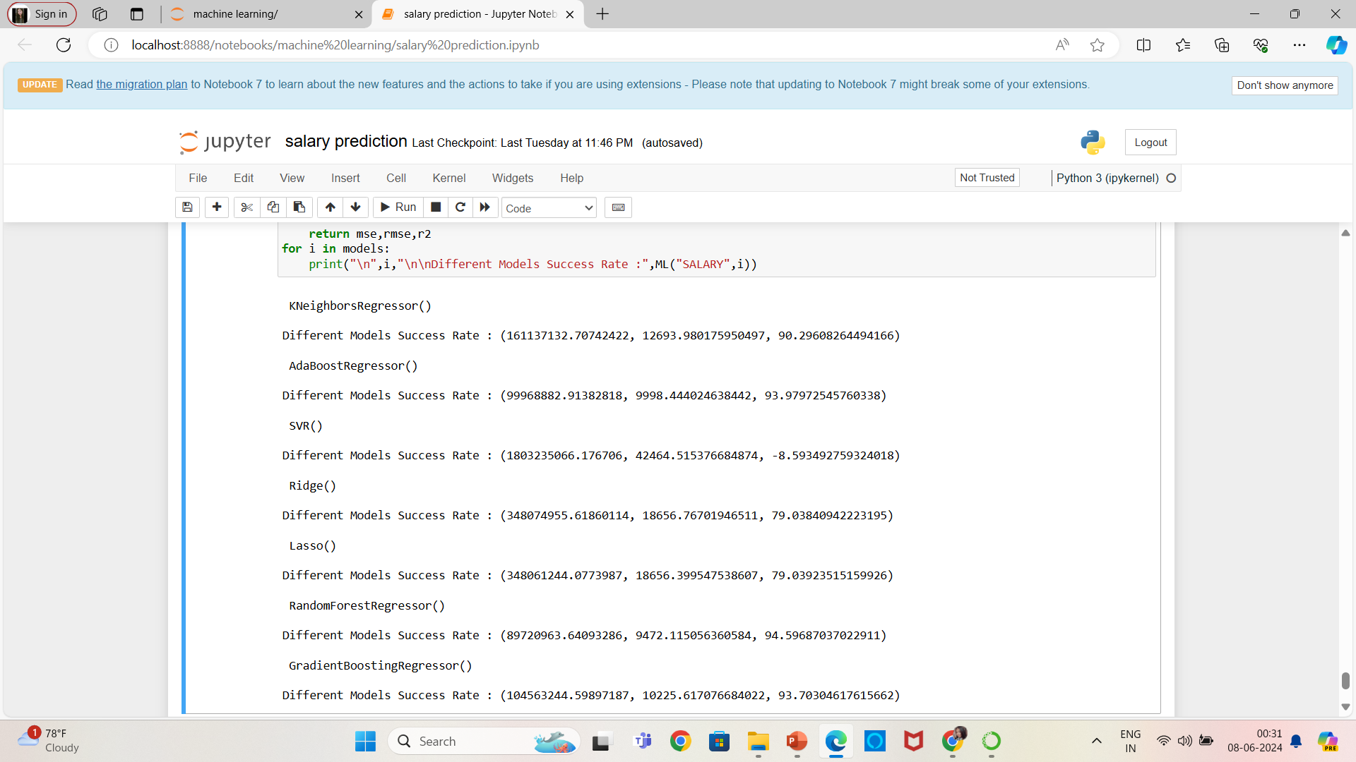
EX:

Slide 15
Conclusion
Summary of Findings: The machine learning models developed in this project effectively predict the salaries of data professionals, highlighting key factors such as experience, education, job role, and location as significant predictors.
Best-Performing Model: Among the models tested, [insert best-performing model, e.g., Random Forest Regressor] demonstrated the highest accuracy and reliability based on evaluation metrics like R-squared and Mean Squared Error.
Implications: The results provide valuable insights for job seekers, employers, and HR analysts, helping them make informed decisions regarding salary expectations and compensation strategies.
Future Work: Further refinement of the models with additional data and advanced techniques could enhance predictive accuracy. Additionally, exploring the impact of emerging trends in the data industry on salary prediction could be beneficial.
Closing Remark: This project underscores the power of machine learning in transforming raw data into actionable insights, ultimately contributing to more transparent and equitable salary practices in the data profession.

Slide 16

THANK YOU!
MENTORNESS

